Slide 1
TIME DOMAIN ANALYSIS
Email: hasansaeedcontrol@gmail.com
URL: http://shasansaeed.yolasite.com/

Slide 2
BOOKS
AUTOMATIC CONTROL SYSTEM KUO & GOLNARAGHI
CONTROL SYSTEM ANAND KUMAR
AUTOMATIC CONTROL SYSTEM S.HASAN SAEED

Slide 3
DEFINITIONS
TIME RESPONSE: The time response of a system is the output (response) which is function of the time, when input (excitation) is applied.
Time response of a control system consists of two parts
1. Transient Response 2. Steady State Response
Mathematically,
Where, = transient response
= steady state response

Slide 4
TRANSIENT RESPONSE: The transient response is the part of response which goes to zero as time increases. Mathematically
The transient response may be exponential or oscillatory in nature.
STEADY STATE: The steady state response is the part of the total response after transient has died.
STEADY STATE ERROR: If the steady state response of the output does not match with the input then the system has steady state error, denoted by .

Slide 5
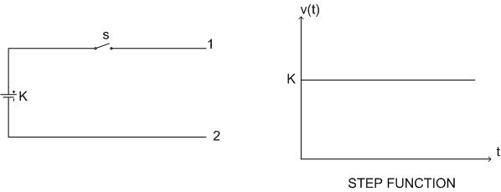
TEST SIGNALS FOR TIME RESPONSE:
For analysis of time response of a control system, following input signals are used
1. STEP FUNCTION:
Consider an independent voltage source in series with a switch ‘s’. When switch open the voltage at terminal 1-2 is zero.

Slide 6
Mathematically,
;
When the switch is closed at t=0
;
Combining above two equations
;
;
A unit step function is denoted by u(t) and defined as
;
;

Slide 7
Laplace transform:
£f(t)=
2. RAMP FUNCTION:
Ramp function starts from origin and increases or decreases linearly with time. Let r(t) be the ramp function then,
r(t)=0 ; t<0
=Kt ; t>0
r(t)
K>0
t

Slide 8
LAPLACE TRANSFORM:
£r(t)
For unit ramp K=1
r(t)
0
t
K<0

Slide 9
3. PARABOLIC FUNCTION:
The value of r(t) is zero for t<0 and is quadratic function of time for t>0. The parabolic function represents a signal that is one order faster than the ramp function.
The parabolic function is defined as
For unit parabolic function K=1

Slide 10
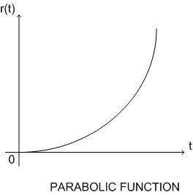
LAPLACE TRANSFORM:
£r(t)

Slide 11
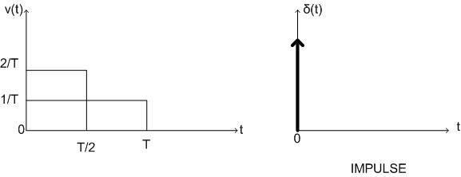
IMPULSE RESPONSE: Consider the following fig.
The first pulse has a width T and height 1/T, area of the pulse will be 1. If we halve the duration and double the amplitude we get second pulse. The area under the second pulse is also unity.

Slide 12
We can say that as the duration of the pulse approaches zero, the amplitude approaches infinity but area of the pulse is unity.
The pulse for which the duration tends to zero and amplitude tends to infinity is called impulse. Impulse function also known as delta function. Mathematically
δ(t)= 0 ; t ≠ 0
=∞ ; t = 0
Thus the impulse function has zero value everywhere except at t=0, where the amplitude is infinite.

Slide 13
An impulse function is the derivative of a step function
δ(t) = u(t)
£δ(t) = £
INPUT r(t) | SYMBOL | R(S)
UNIT STEP | U(t) | 1/s
UNIT RAMP | r(t) | 1/s²
UNIT PARABOLIC | - | 1/s³
UNIT IMPULSE | δ(t) | 1

Slide 14
THANK YOU
FOR
ATTENTION

